Slide 1
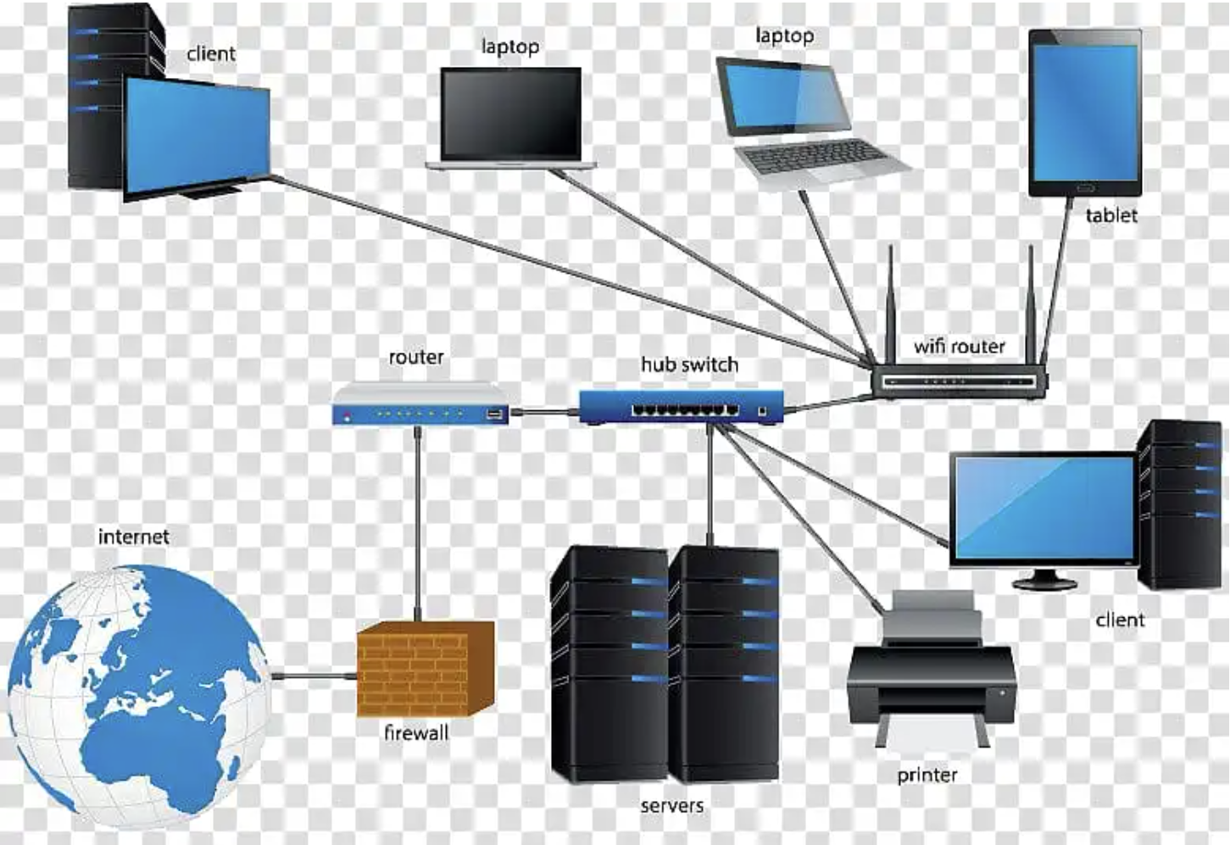
Network
Network: Network is a group of two or more computers connected together, for the exchange of data and sharing of resources (such as printers and CD-ROMs)

Slide 2
Advantage and Application
Fast Service / Time Saving
Information / Data Sharing
High Security
High Reliability / Easy to Backup
Resources Sharing
Communications
Software can be shared
Cost reduced and Easy Maintenance

Slide 3
Types of Networks (By Scale)
LAN – Local Area Network
WLAN – Wireless Local Area Network
CAN – Campus Area Networks
MAN – Metropolitan Area Network
WMAN – Wireless Metropolitan Area Network
WAN – Wide Area Network
WWAN – Wireless Wide Area Network
GAN – Global Area Network
PAN – Personal Area Network
SAN – Storage Area Network

Slide 4
Network Hierarchies (By Architecture)
Peer-to-Peer Networks
Client / Server Networks

Slide 5
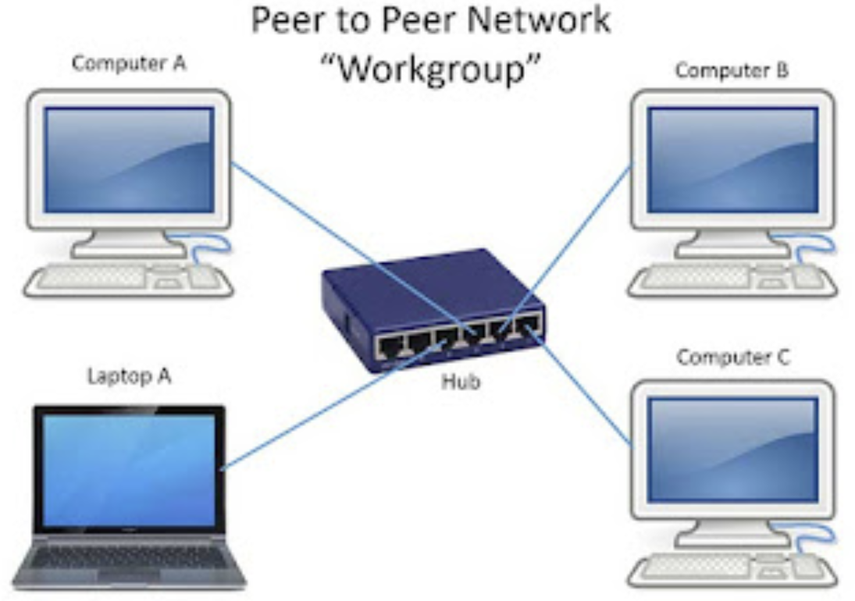
Network Hierarchies (By Architecture)
Peer-to-Peer Networks

Slide 6
Peer-to-Peer Networks
Suitable for small to Medium Size Organizations
Advantages:
No dedicated server
Less expensive
Easy to install and maintain
Good file, printer, and CD-ROM sharing
Disadvantages:
Slow operation
Not good for database applications
Less reliable (server is workstation)
Low security
Limited expandability

Slide 7
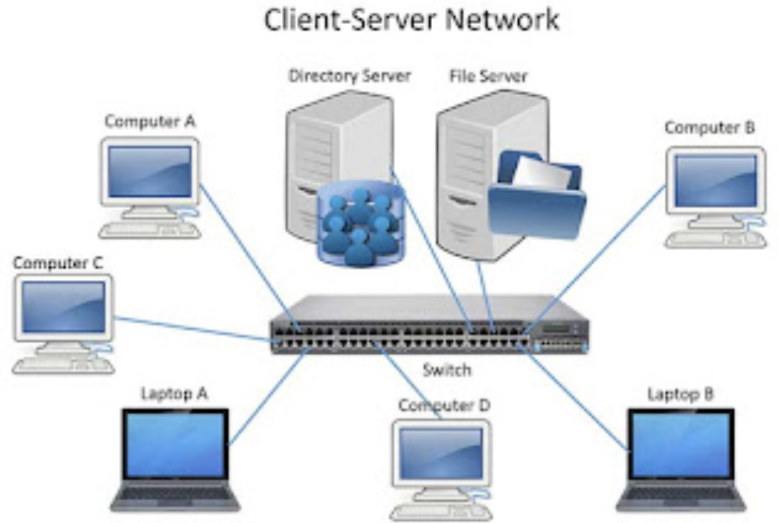
Network Hierarchies (By Architecture)
Client / Server Networks

Slide 8
Client / Server Networks
Suitable for Medium to Large Size Organizations
Advantages:
Fast operation
Expandable
Will work with any application
Handles shared database applications
More reliable (dedicated server)
Highest level of security
Applications can be shared

Slide 9
Client / Server Networks
Suitable for Medium to Large Size Organizations
Disadvantages:
Needs dedicated server
More expensive to buy
More expensive to maintain

Slide 10
Internet
The Internet is a worldwide, publicly accessible series of interconnected computer networks that transmit data by packet switching using the standard Internet Protocol (IP).
It is a “network of networks” that consists of millions of smaller domestic, academic, business, and government networks, which together carry various information and services, such as electronic mail, online chat, file transfer, and the interlinked web pages and other resources of the World Wide Web (WWW).
Internet is a collection of interconnected computer networks, linked by copper wires, fiber-optic cables, wireless connections, etc.

Slide 11
ICANN
The Internet Corporation for Assigned Names and Numbers (ICANN) is the authority that coordinates the assignment of unique identifiers on the Internet, including domain names, Internet Protocol addresses, and protocol port and parameter numbers.
A globally unified namespace (i.e., a system of names in which there is one holder of each name) is essential for the Internet to function. ICANN is a headquartered in Marina del Rey, California, but is overseen by an international board of directors drawn from across the Internet technical, business, academic, and non-commercial communities.
Common Uses of Internet:
EMAIL WORLD WIDE WEB REMOTE ACCESS
COLLABORATION FILE SHARING
STREAMING MEDIA VOICE TELEPHONE (VoIP)

Slide 12
Intranet
An intranet is a set of interconnected networks, using the Internet Protocol and uses IP-based tools such as web browsers, that is under the control of a single administrative entity. That administrative entity closes the intranet to the rest of the world, and allows only specific users. Most commonly, an intranet is the internal network of a company or other enterprise.

Slide 13
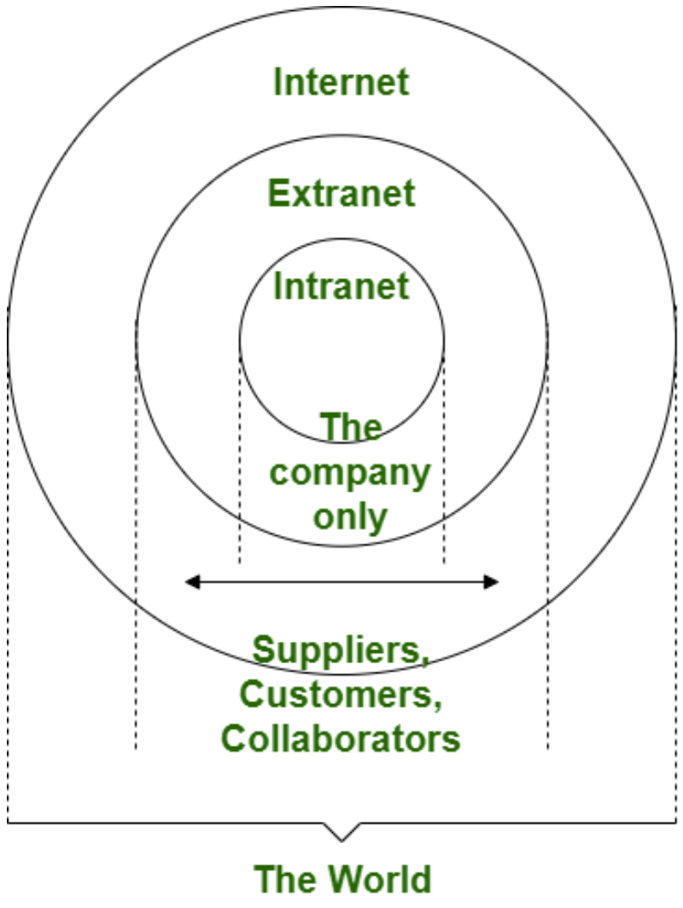
Extranet
An extranet is a private network that uses Internet protocols, network connectivity, and possibly the public telecommunication system to securely share part of an organization’s information or operations with suppliers, vendors, partners, customers or other businesses.
An extranet can be viewed as part of a company’s intranet that is extended to users outside the company, usually via the Internet.

Slide 14
Point of difference | Internet | Intranet | Extranet
Accessibility of network | Public | Private | Private
Availability | Global | specific to an organization | Share information with suppliers and vendors it makes the use of public network
Coverage | All over the world | Restricted area upto an organization | Restricted area upto an organization and some of its stakeholders
Accessibility of content | It is accessible to everyone connected | It is accessible only to the members of organization | Accessible only to the members of organization and external members with logics
No. of computers connected | It is largest in number of connected devices | The minimal number of devices are connected | The connected devices are more comparable with intranet
Owner | No one | Single organization | Single/Multiple organization

Slide 15
Point of difference | Internet | Intranet | Extranet
Purpose of the network | Share information throughout the world | Share information throughout the organization | Share information between members and external members
Security | Dependent on the user of the device connected to network | Enforced via firewall | Enforced via firewall that separates internet and extranet
Users | General public | Employees | Employees
Policies behind setup | No hard and fast rule | Imposed | Imposed
Maintenance | ISP | CIO, HR Dept. | CIO HR Dept.
Economical | More economical | Less economical | Less economical
Relation | Network of networks | Derived from Internet | Derived from Intranet
Example |  | WIPRO | DELL and Intel

Slide 16
Network Topologies
Topology: The geometrical arrangement of a computer systems in a network.
Topology refers to the shape of a network, or the network’s layout. How different nodes in a network are connected to each other and how they communicate are determined by the network’s topology.
Common topologies include a Bus, Star, Ring

Slide 17
BUS / Linear Topology
The network with linear cabling has a single backbone, one main cable that runs from one end of the system to the other. Along the way, PCs tap into this backbone with a single cable through which they both send and receive.
In effect, the network backbone functions as a data bus, and this configuration is often called as bus topology.
Advantages:
Easy to connect a computer or peripheral to a linear bus
Requires less cable length than a star topology
Disadvantages:
Entire network shuts down if there is a break in the main cable
Terminators are required at both ends of the backbone cable

Slide 18
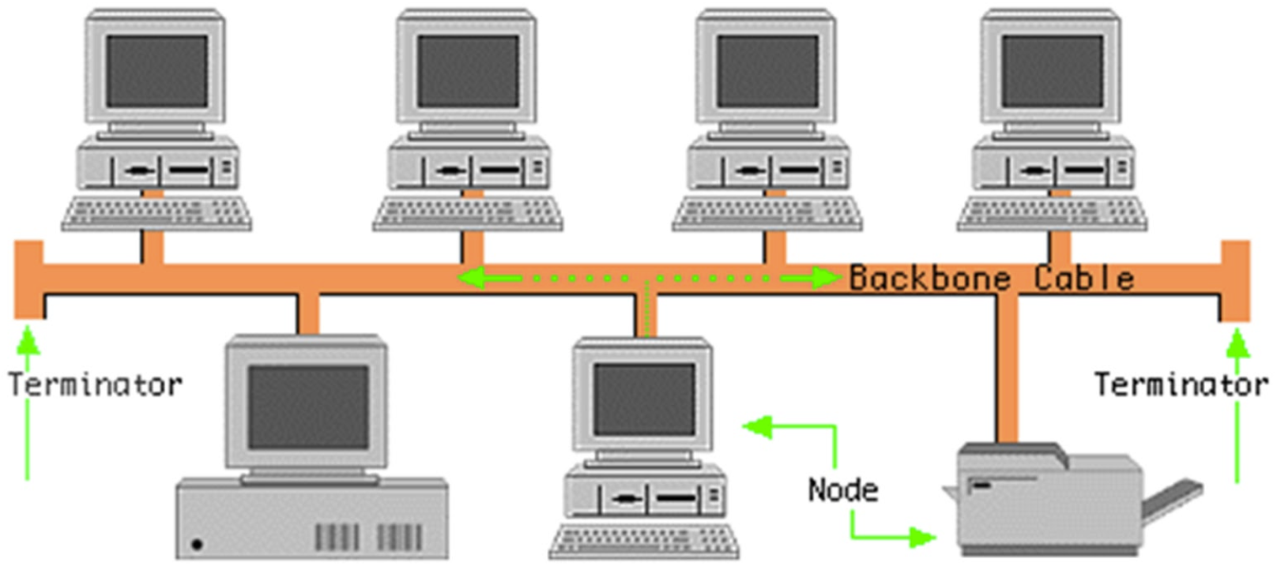
BUS / Linear Topology
Disadvantages:
Difficult to identify the problem if the entire network shuts down
Not meant to be used as a stand-alone solution in a large building

Slide 19
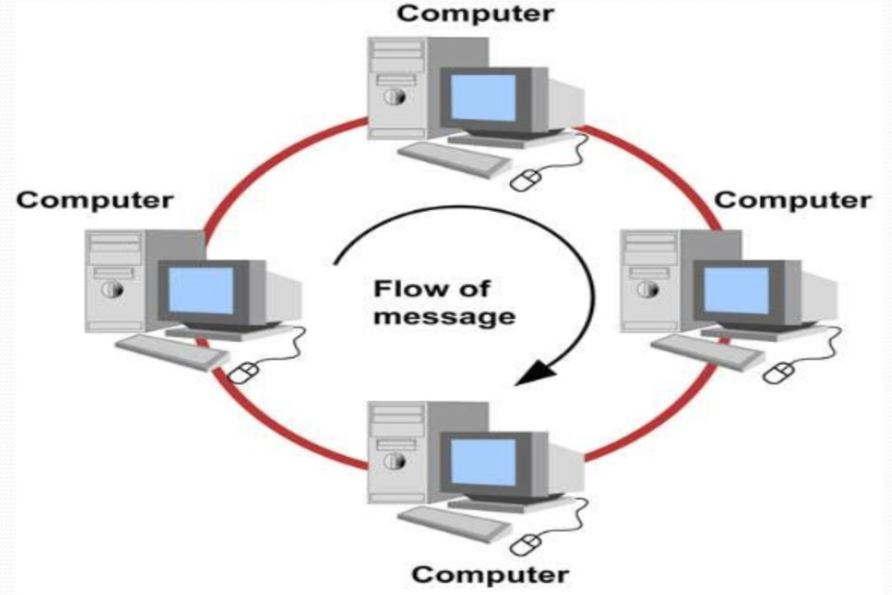
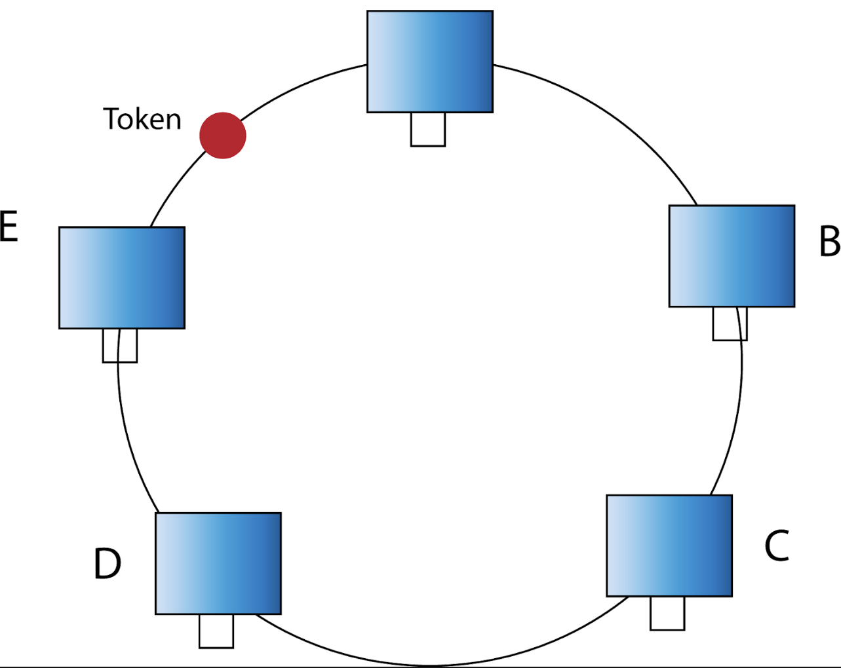
Ring Topology
The ring topology looks like a linear network that biting its own tail. The backbone is continues loop, a ring, with no end. But the ring is not a single continues wire. Instead it is made of short segments daisy chained from one PC to the next, last connected, in turn, to the first.
Each PC thus has two connections. One wire connect a PC to the PC before it in the ring, and a second wire leads to the next PC in the ring.
Signals must traverse through one PC to get to the next, and the signals typically or listed to and analyzed along the way.

Slide 20
Star Topology
In the star topology connecting cables emanate from a centralized location called a Hub, and each cable links a single PC in to the network. In the most popular network systems based on the star topology, each cable is actually twofold.
Each has two distinct connections, one for sending data from the Hub to an individual PC and one for the PC to send data back to the Hub. These paired connections are typically packaged in to a single cable.
Advantages:
Easy to install and wire
No disruptions to the network then connecting or removing devices
Easy to detect faults and to remove parts
Disadvantages:
Requires more cable length than a linear topology
If the hub or concentrator fails, nodes attached are disabled

Slide 21
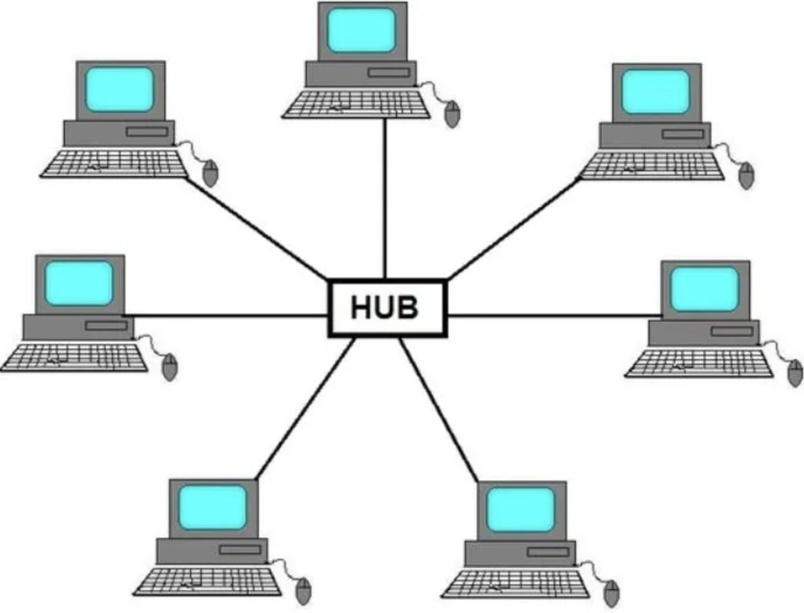
Star Topology
Disadvantages:
More expensive than linear bus topologies because of the cost of the concentrators

Slide 22
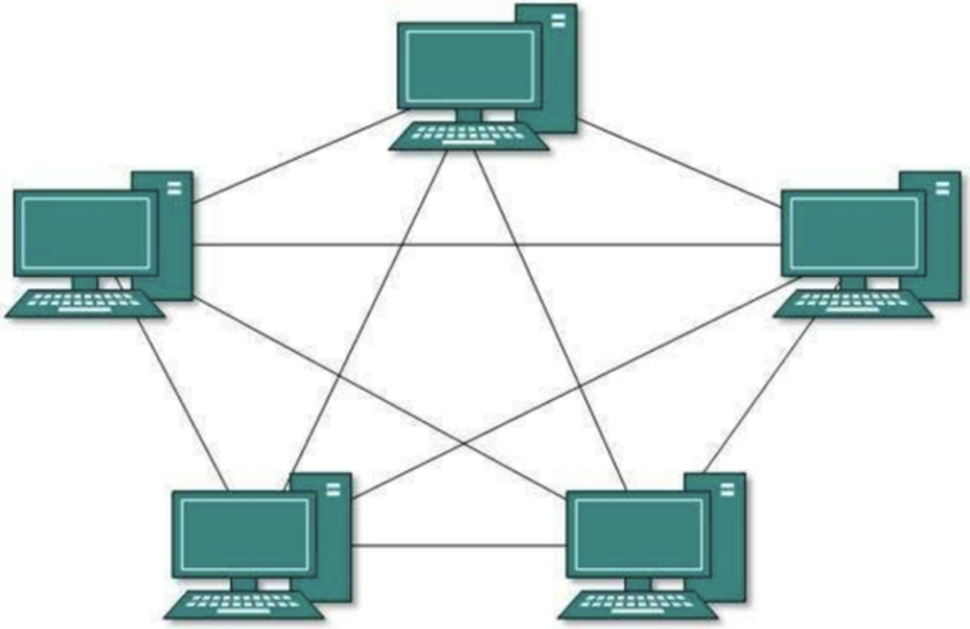
Mesh / Fully Connected
The type of network topology in which each of the nodes of the network is connected to each of the other nodes in the network with a point-to-point link – this makes it possible for data to be simultaneously transmitted from any single node to all of the other nodes.
The physical fully connected mesh topology is generally too costly and complex for practical networks, although the topology is used when there are only a small number of nodes to be interconnected.

